Slide 1
Online Book Review System

Slide 2
218 Java SL JM-RLL-Group-7

Slide 3
Done By
Id | Name | Batch | Group
2500955 | Kothagundla Vijaya Lakshmi | 218 Java SL JM | 7
2499867 | Bakka Bhargav | 218 Java SL JM | 7
2500645 | Chennareddy Mahesh | 218 Java SL JM | 7
2500675 | Bethala Ravi Kiran | 218 Java SL JM | 7
2500731 | Sai Kartheek Ilapavuluri | 218 Java SL JM | 7
2499919 | Kapil Davey | 218 Java SL JM | 7
2500414 | Shaik Mohammad Shakeer | 218 Java SL JM | 7
2500913 | Mayank Gupta | 218 Java SL JM | 7
2500256 | Sonu Kumar | 218 Java SL JM | 7
2500908 | Sagar Rao Salanke P | 218 Java SL JM | 7
2500924 | Dakka Basteen Benny | 218 Java SL JM | 7

Slide 4
Project Objective
Create a dynamic and responsive Java full stack web application to build a book review website.

Slide 5


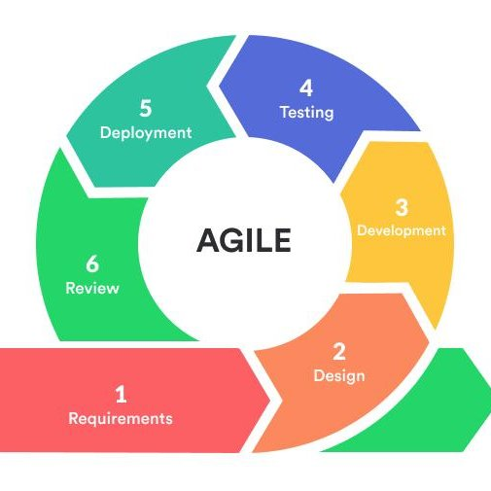




Tools and Technologies

Slide 6
Background of the project
“ENZ Book Club” is an online book review blog where users can register and share their reviews on a list of books.
Users can like, comment and share the books which are good reads.
As a result, the team decided to hire a Full Stack developer who could develop a book review blog with a rich and user-friendly interface.
As a Full Stack Java developer we were asked to develop the web application.
The management team has provided us with the requirements and their business model so we can arrange different components of the application.

Slide 7
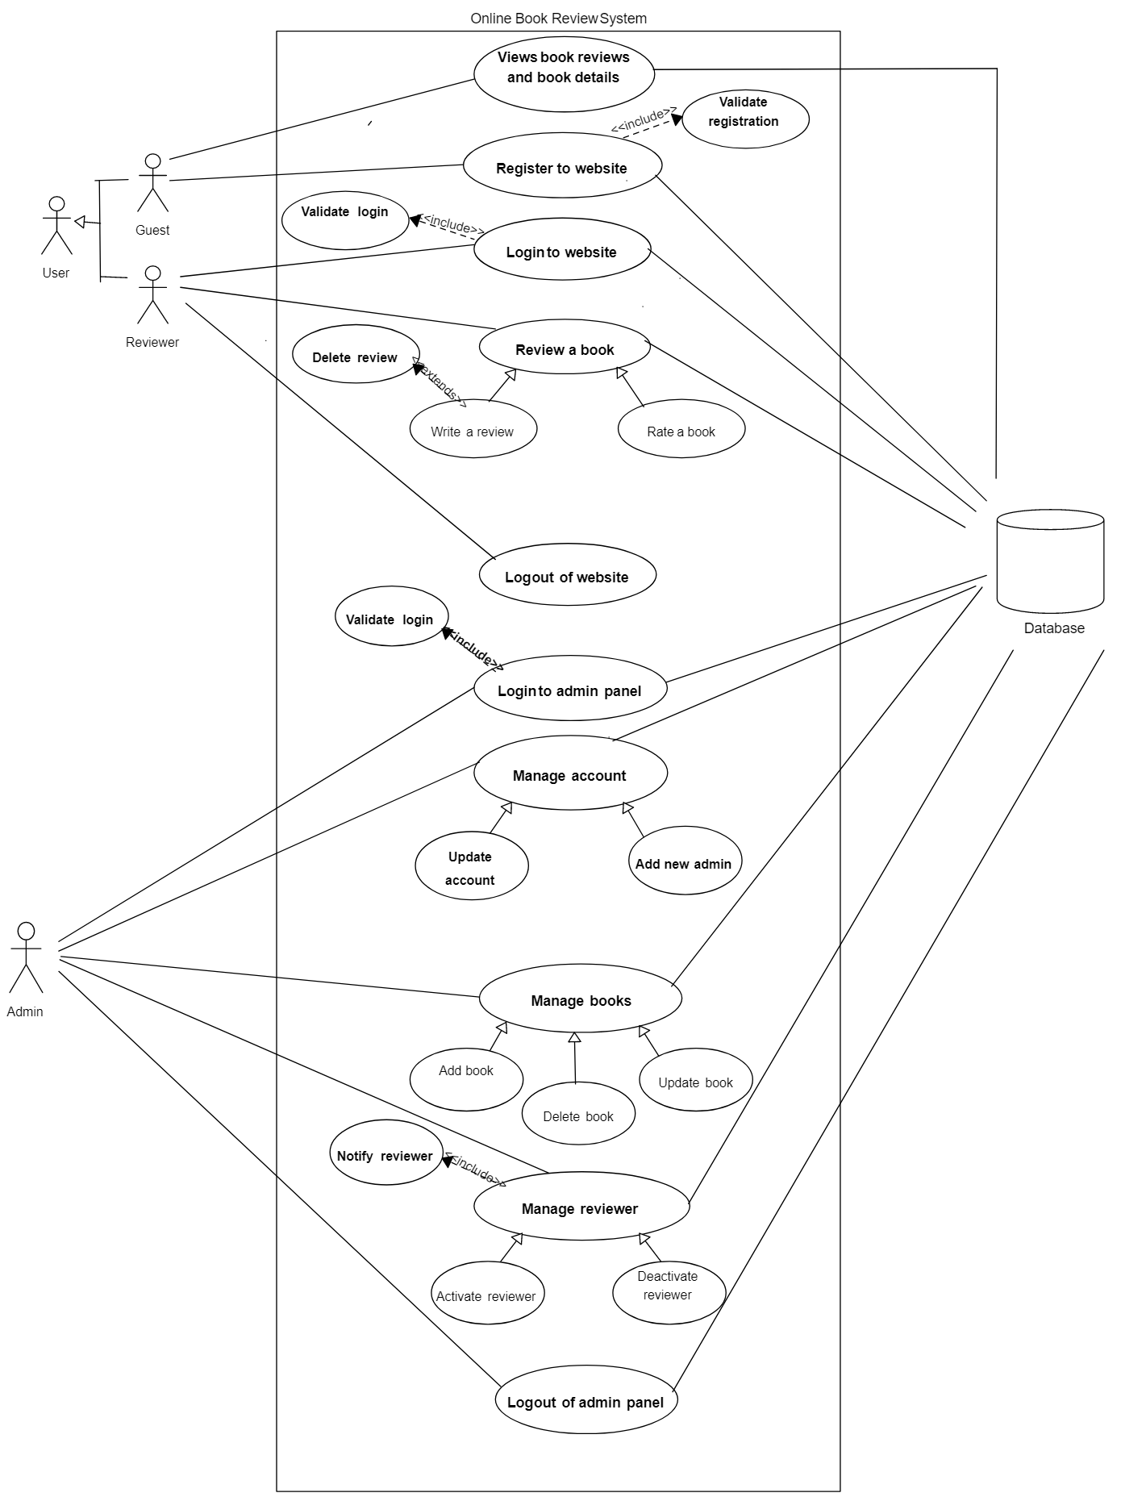
WORKFLOW

Slide 8
Functional Requirements 1. Admin Portal 2. User Portal

Slide 9
1. Admin Portal

Slide 10
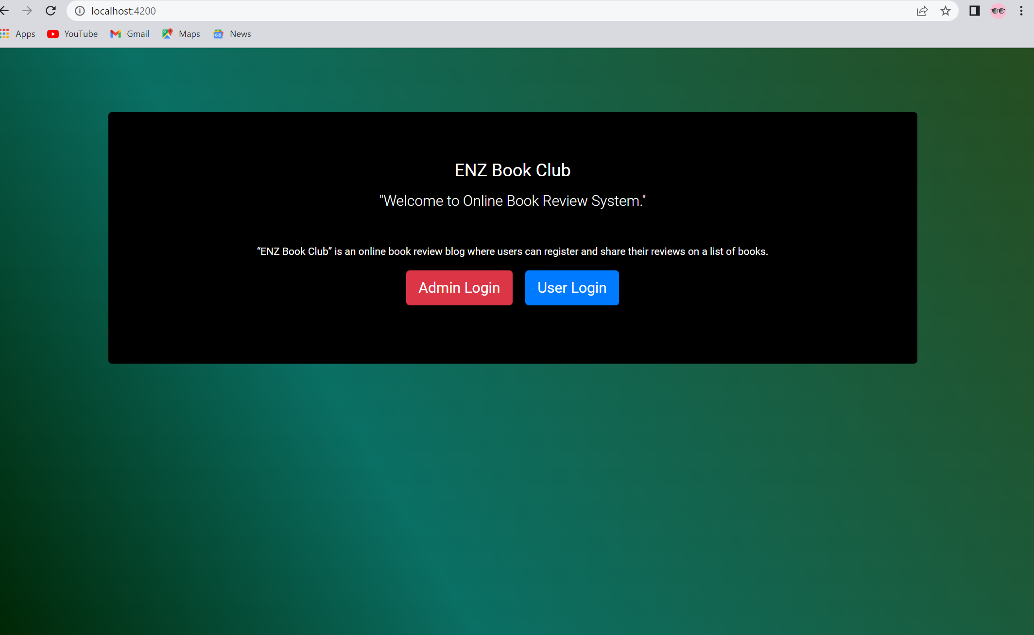
ENZ Book Club Home Page
Click on “Admin Login” to login to the Admin portal

Slide 11
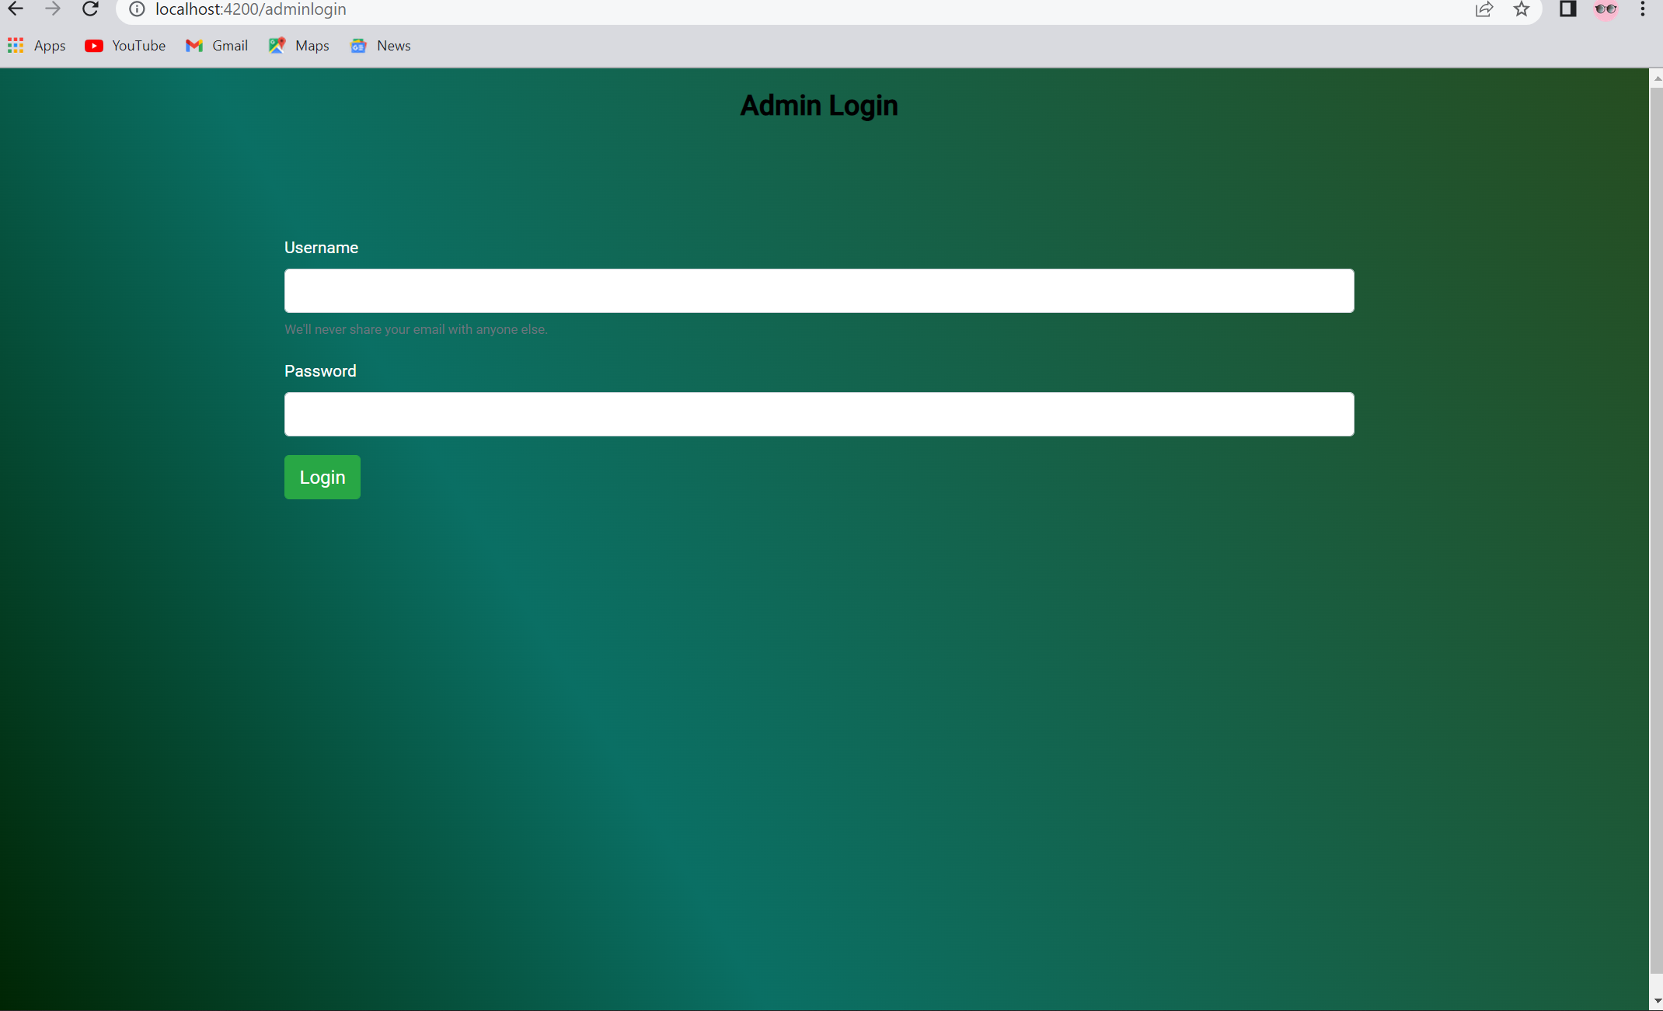
Login to Admin Account
Enter Admin user credentials and click “Login” to proceed

Slide 12
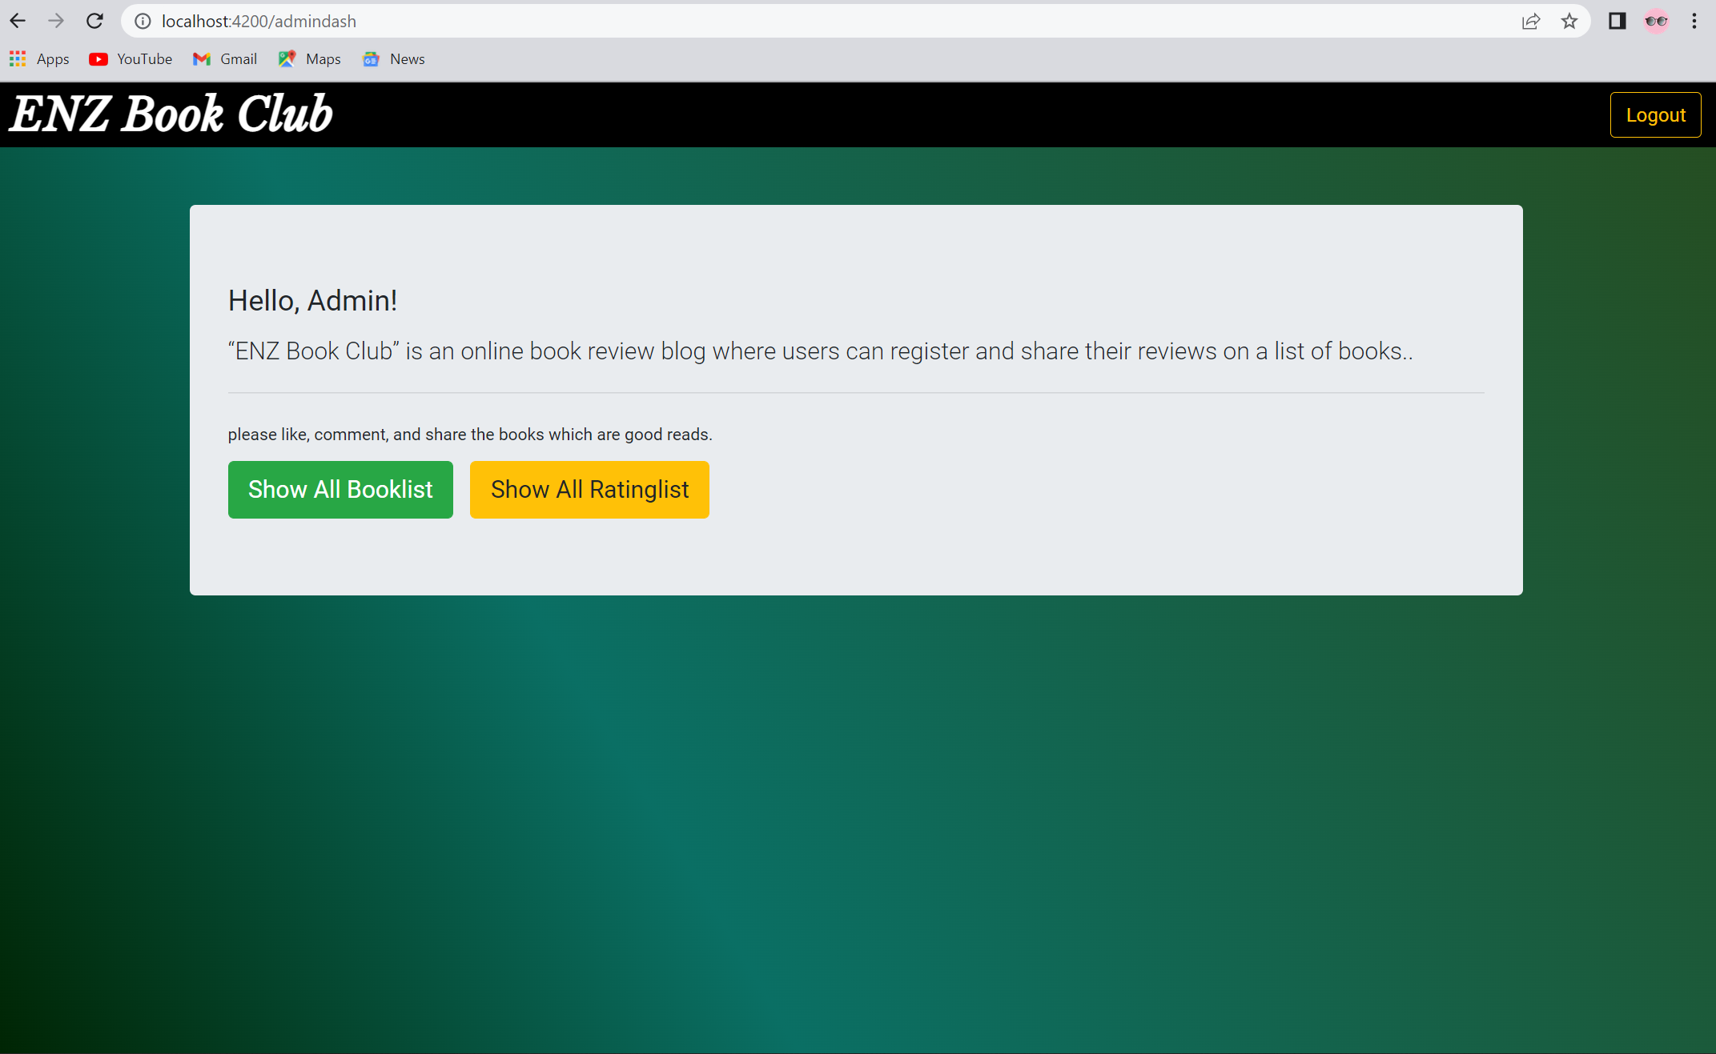
Admin Login Successful
Select any one operation to be performed from the above two options to proceed

Slide 13
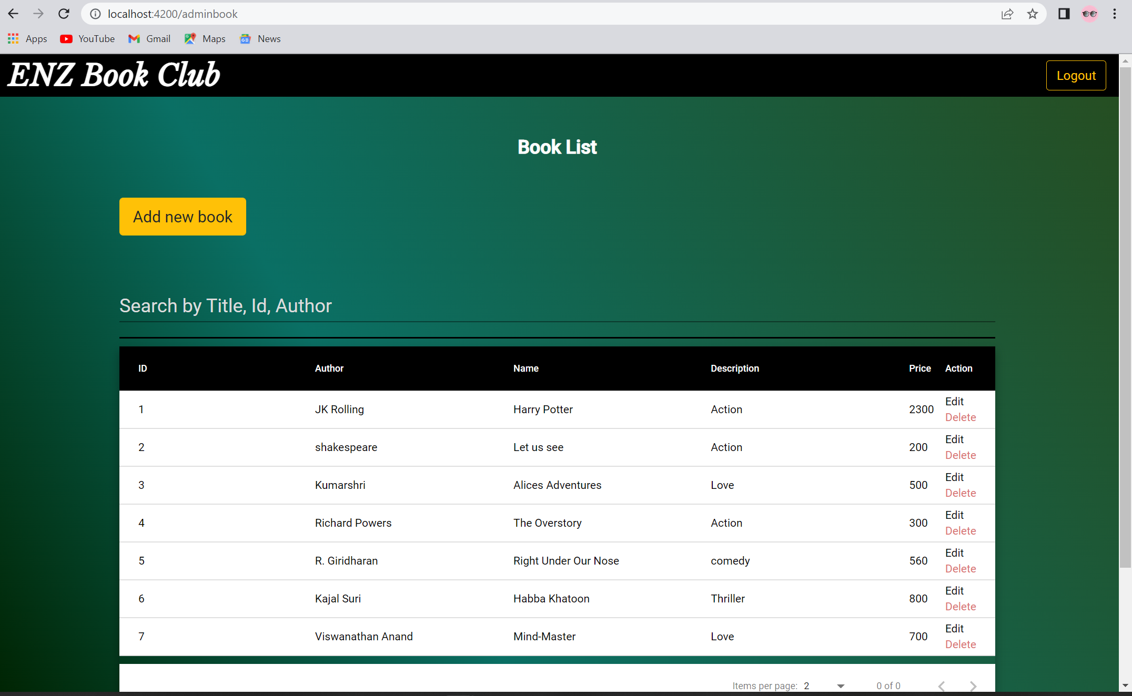
Addition of new book with price
Select operation to add a new book

Slide 14
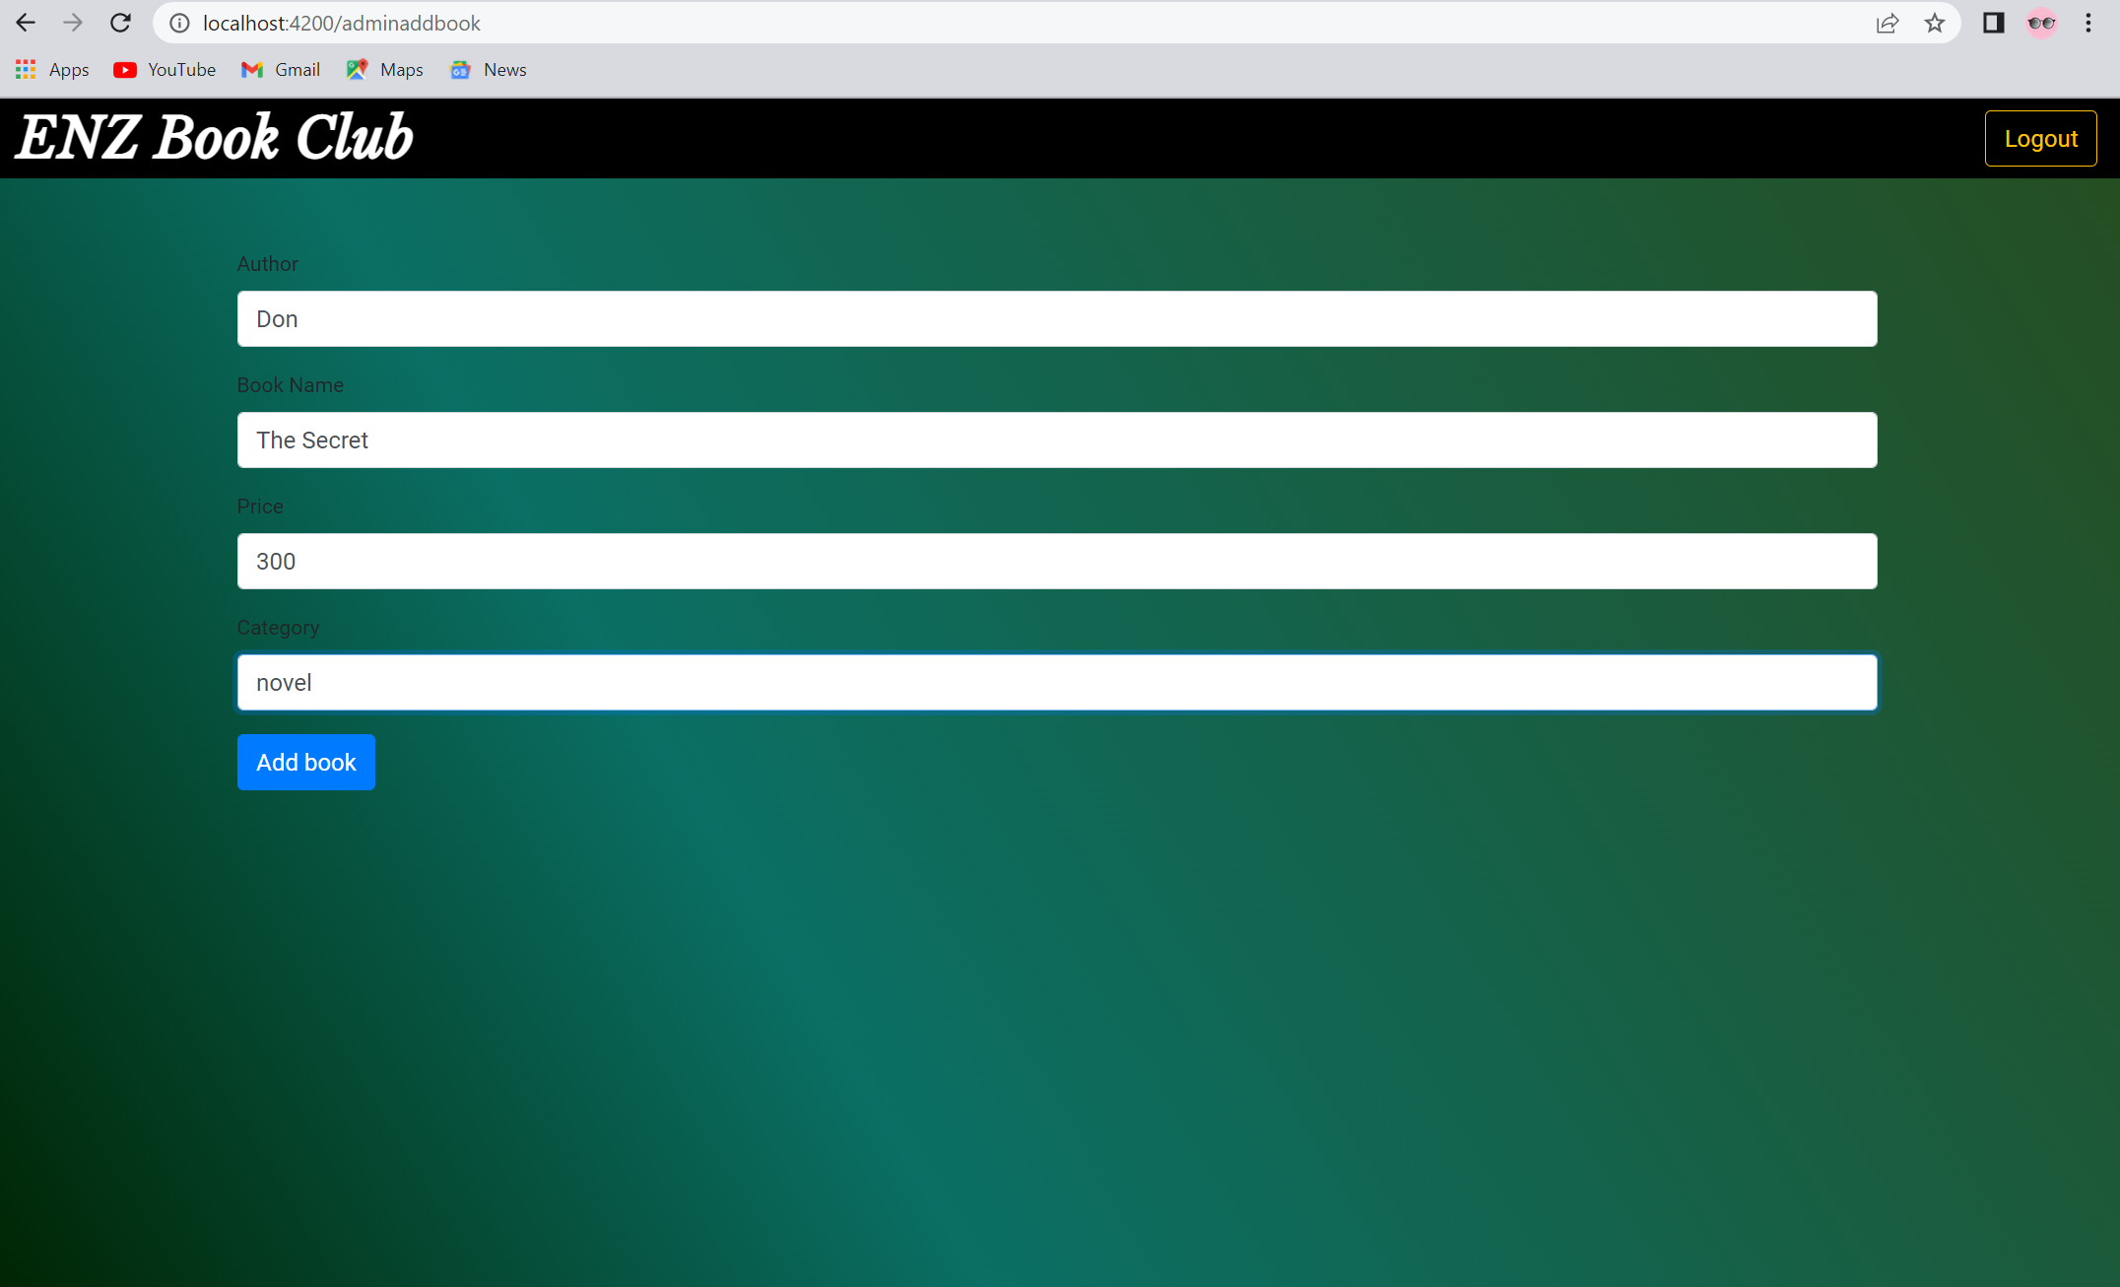
Addition of new book with price
Enter all the above details and click on “Add book” to add a new book

Slide 15
Editing book details for updating
Click on “Edit” operation to edit book details

Slide 16

Editing book details for updating
Enter all the above details and click on “Update book” to update the details of the book

Slide 17
Ratings, likes and comments of the book
Click on “Show all Ratinglist” to view the ratings, likes, and comments of the book

Slide 18
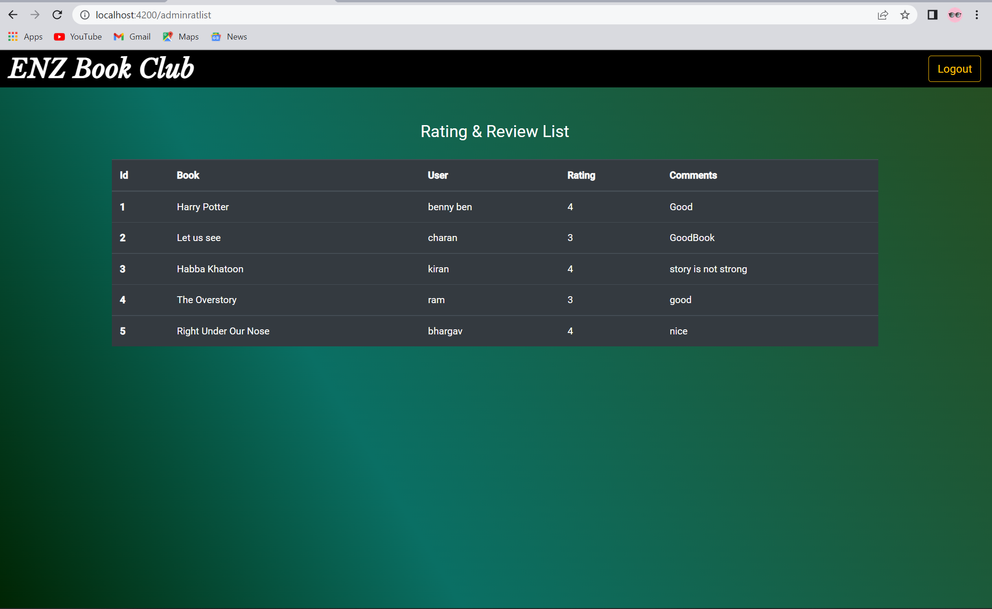
Ratings and Review screen appears

Slide 19
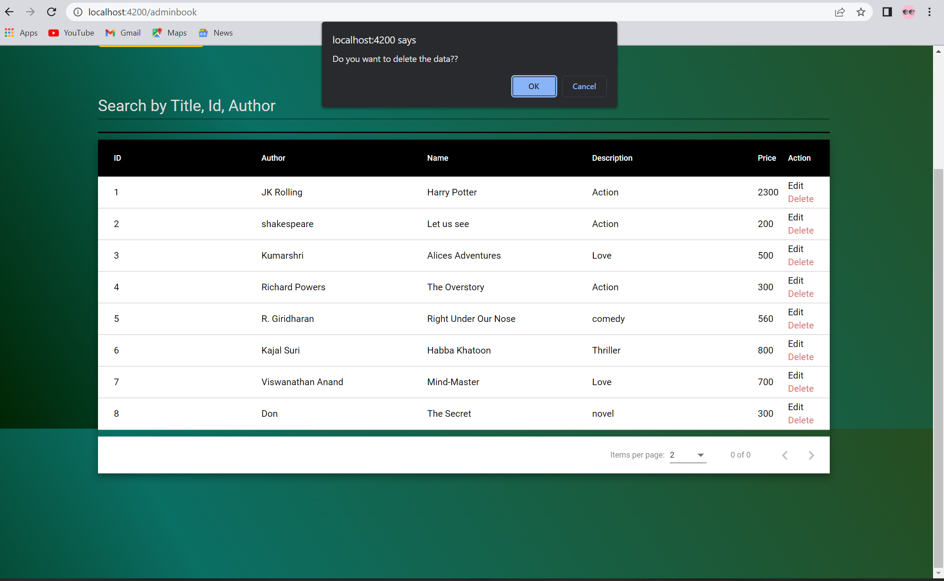
Enable and Disable books
2. Click “Ok” to proceed
1. Click on “Delete” operation to disable the book and check box appears as above.

Slide 20
2. User Portal

Slide 21
ENZ Book Club Home Page
Click on “User Login” to login to the user portal

Slide 22
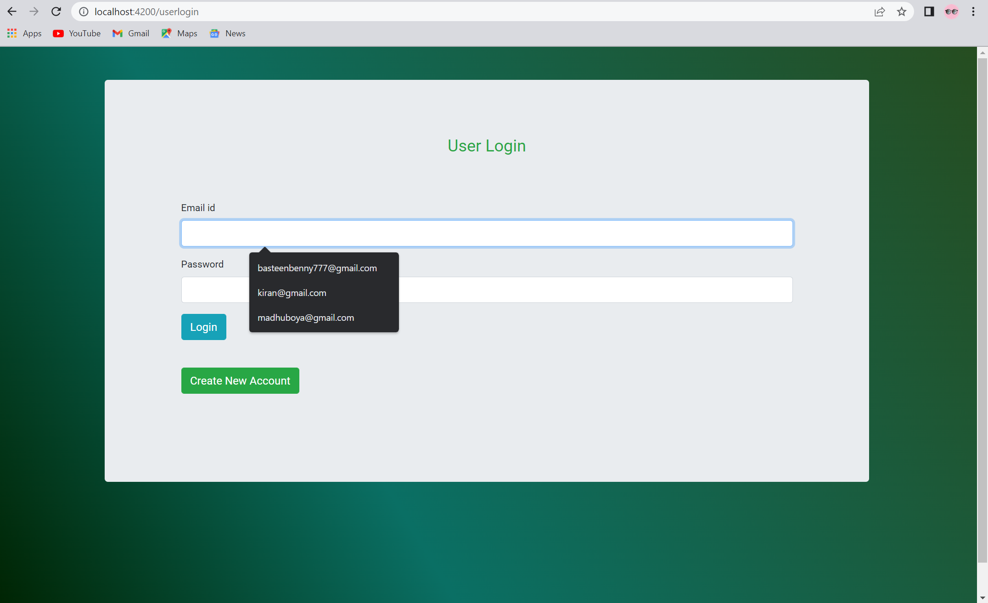
User Portal Login
New users click on “Create new account” to create new user account
Existing users enter user credentials and click on “Login” to login to the user portal.

Slide 23
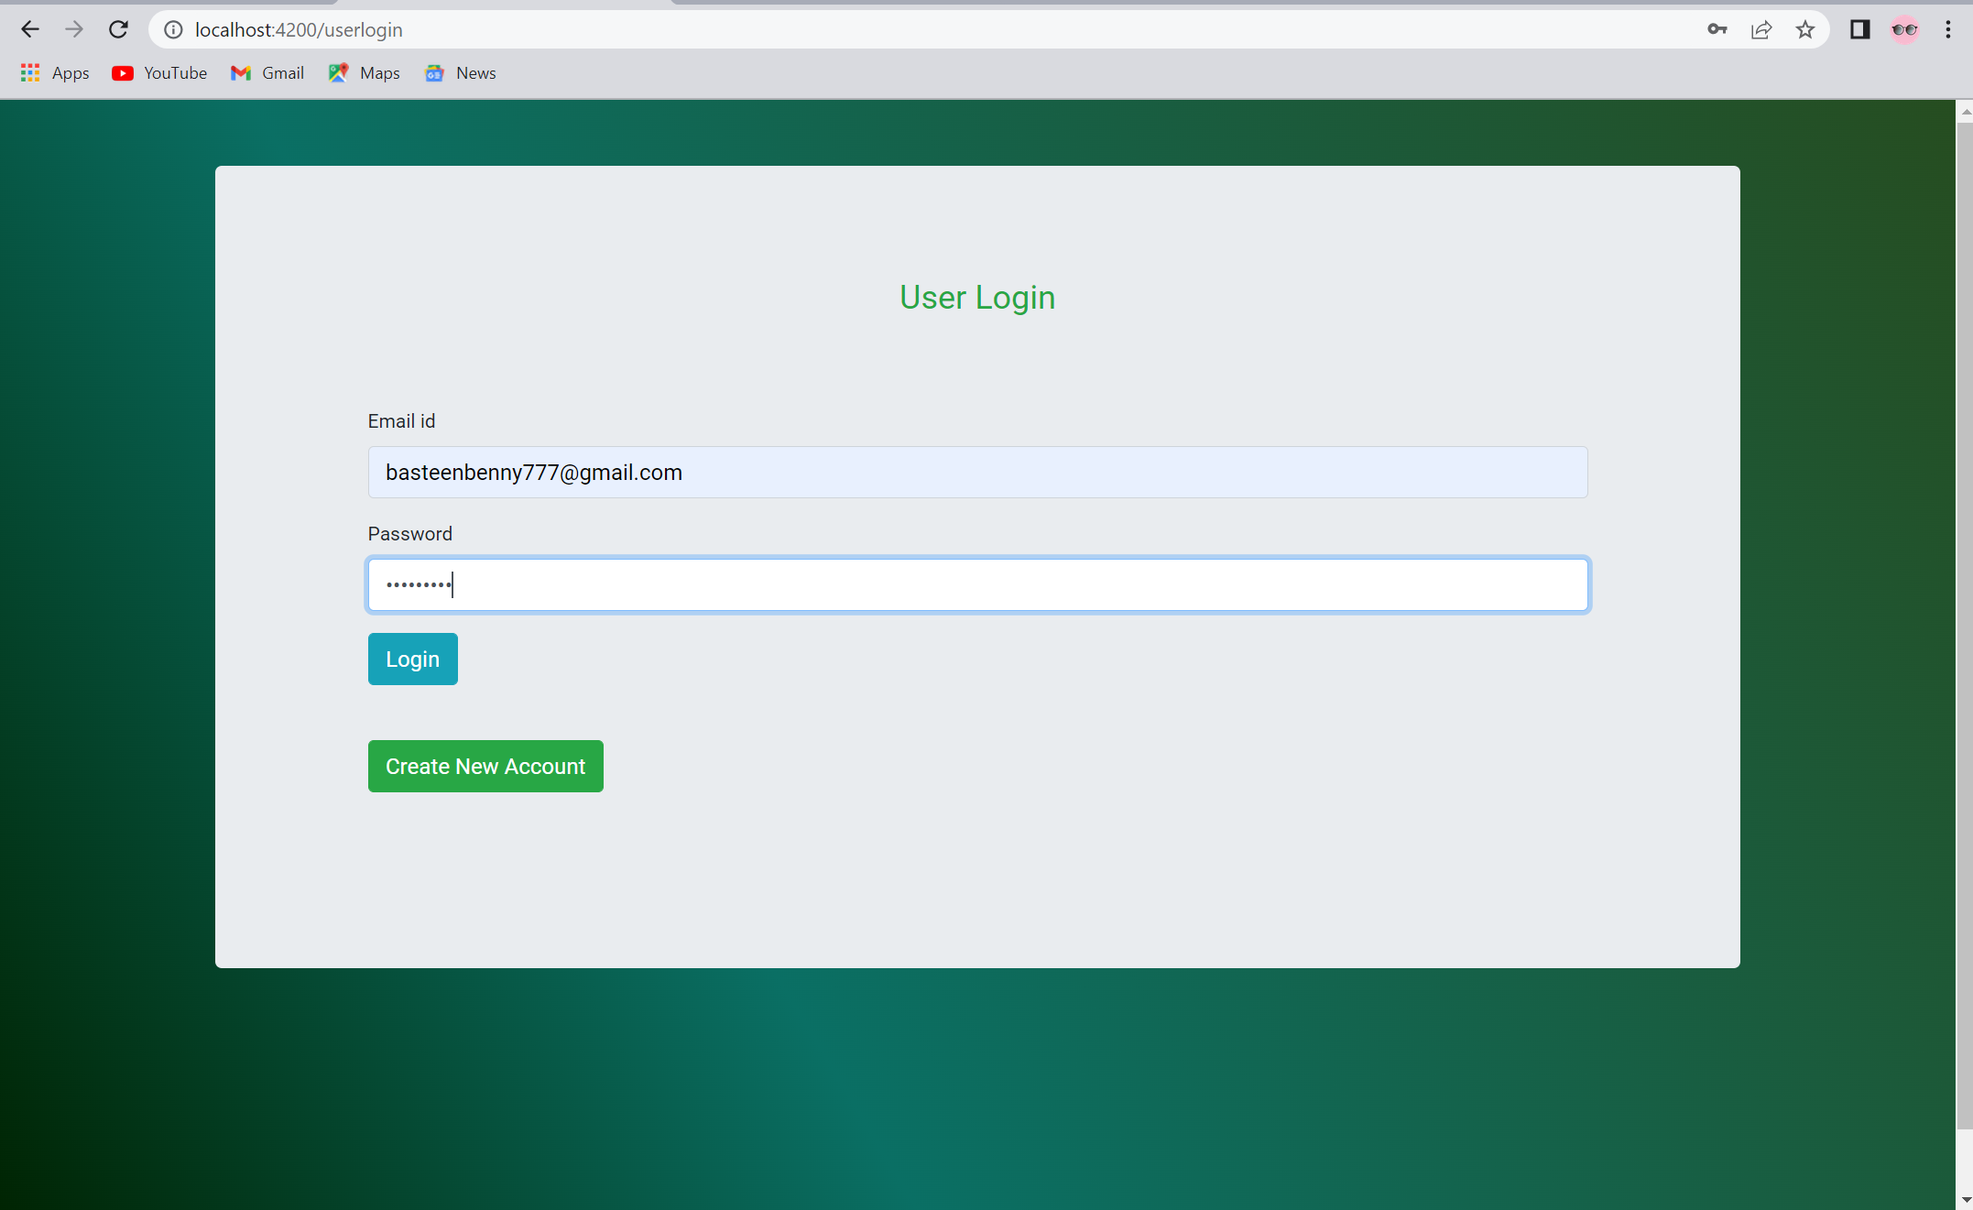
Sign in to maintain record of activities

Slide 24
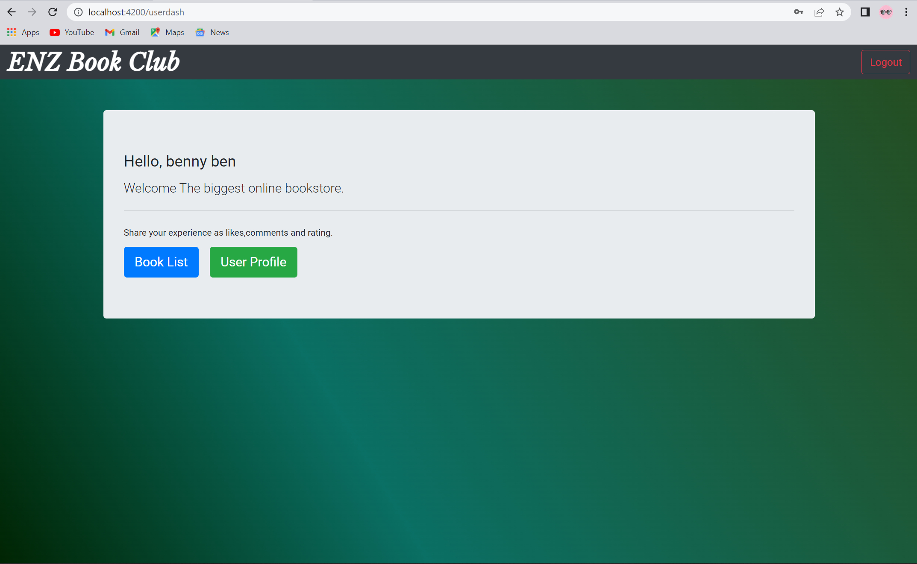
User Portal Login successful
Select any one operation to be performed from the above two options to proceed

Slide 25
Update Profile and Change password
Click on “User profile” to change password and update user profile

Slide 26
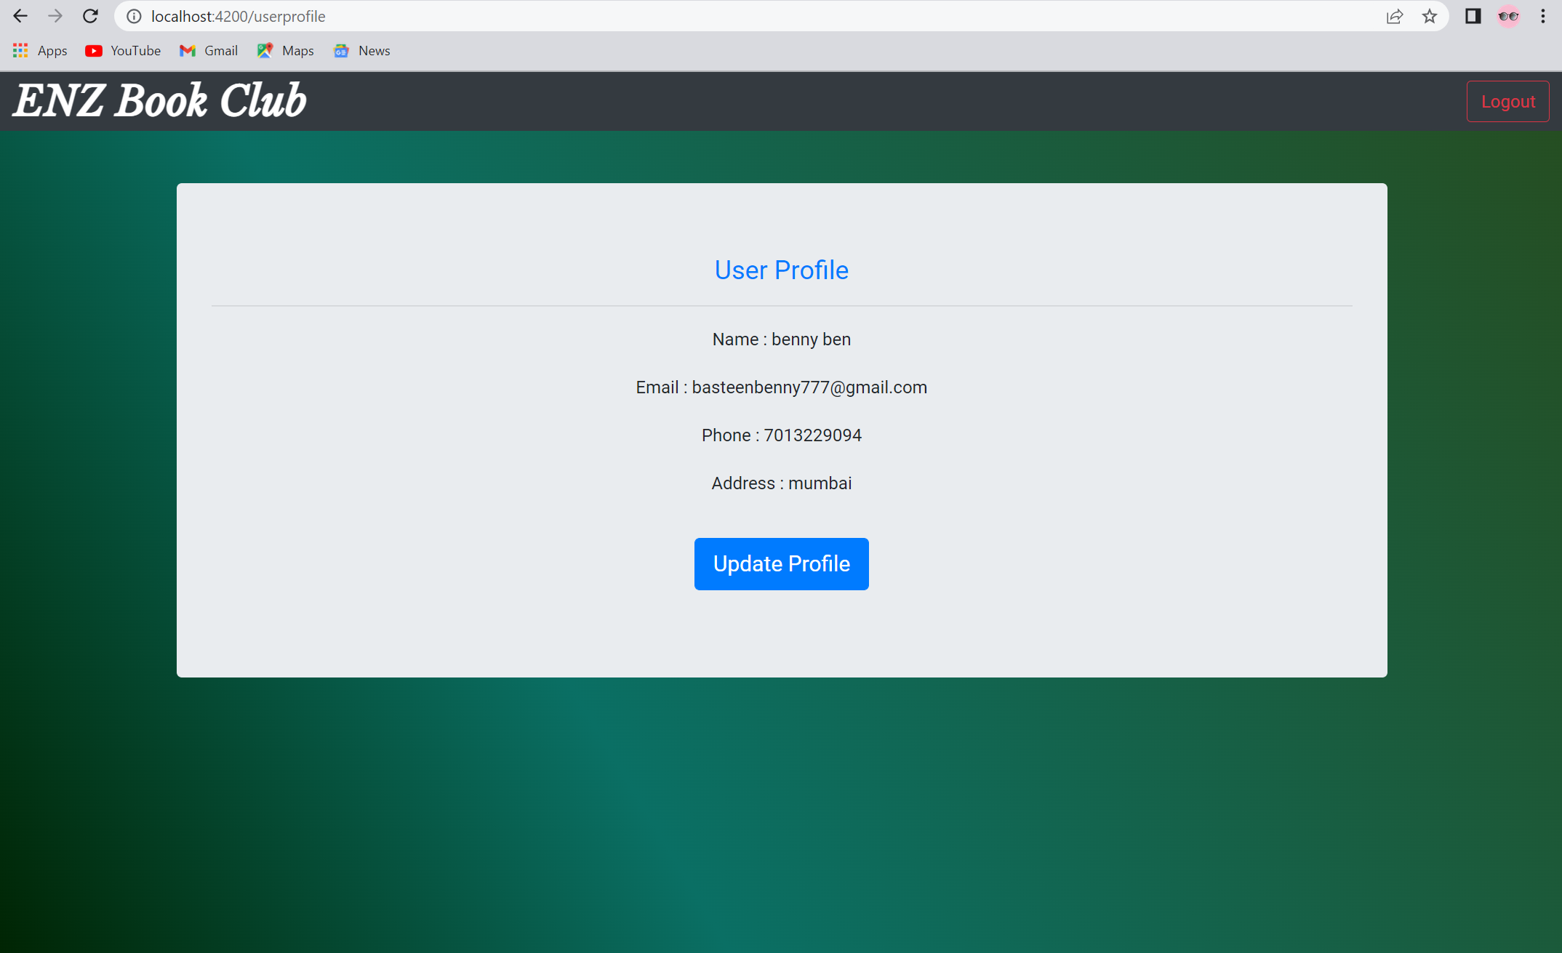
Update Profile and Change password
Existing profile appears. Click on “ Update profile” to update the user profile details

Slide 27
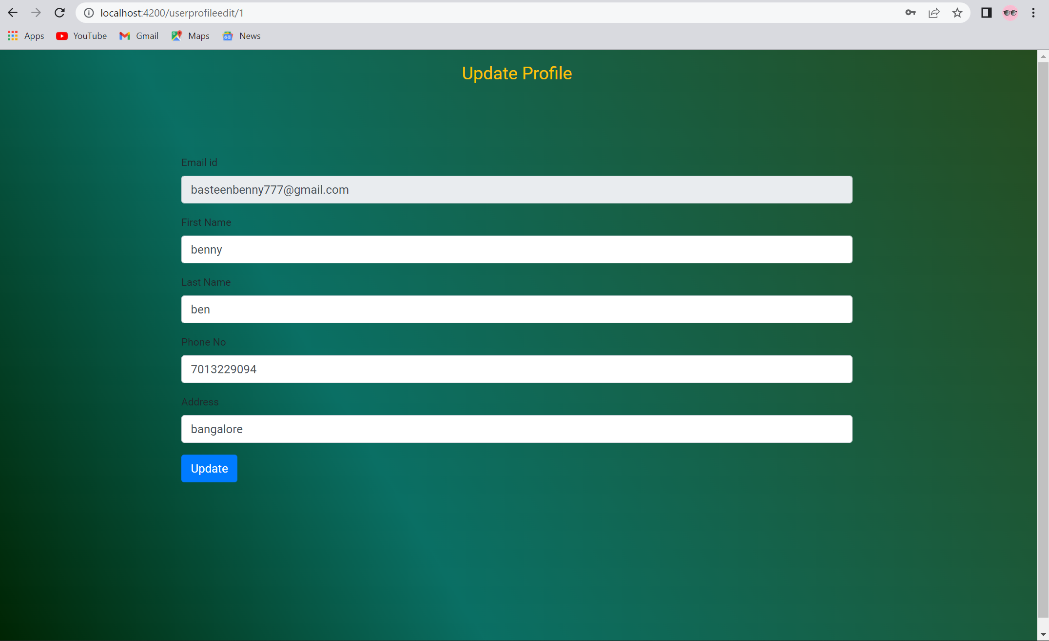
Update Profile
Enter details to be updated in respective section and Click on “ Update” to update the user profile details

Slide 28
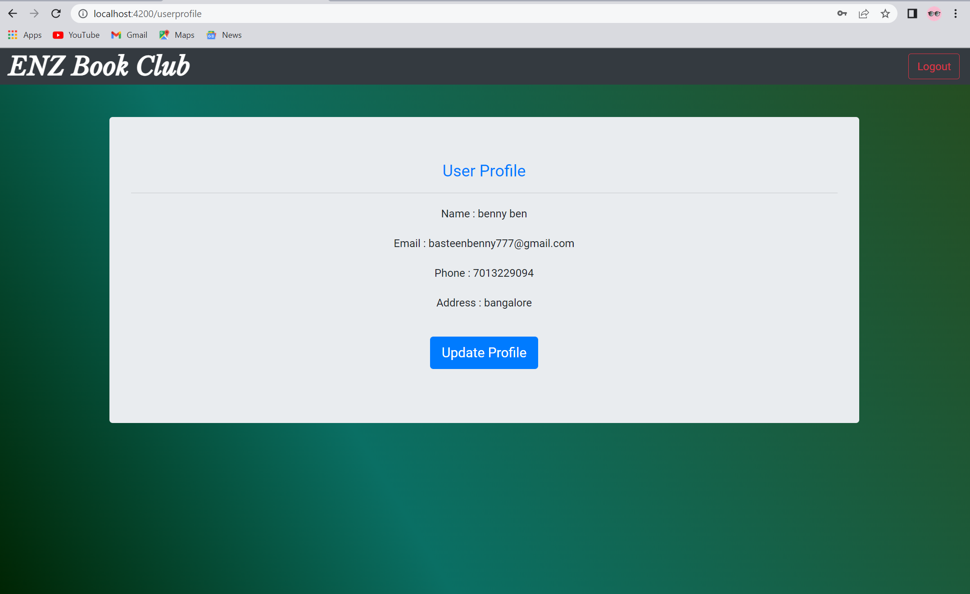
User Profile updated successfully

Slide 29
Search for books based on the search keyword
Click on “Book list” to view book list

Slide 30
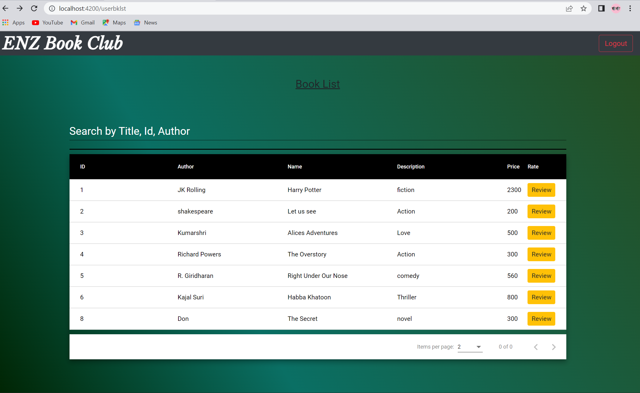
Search for books based on the search keyword
Book list appears

Slide 31
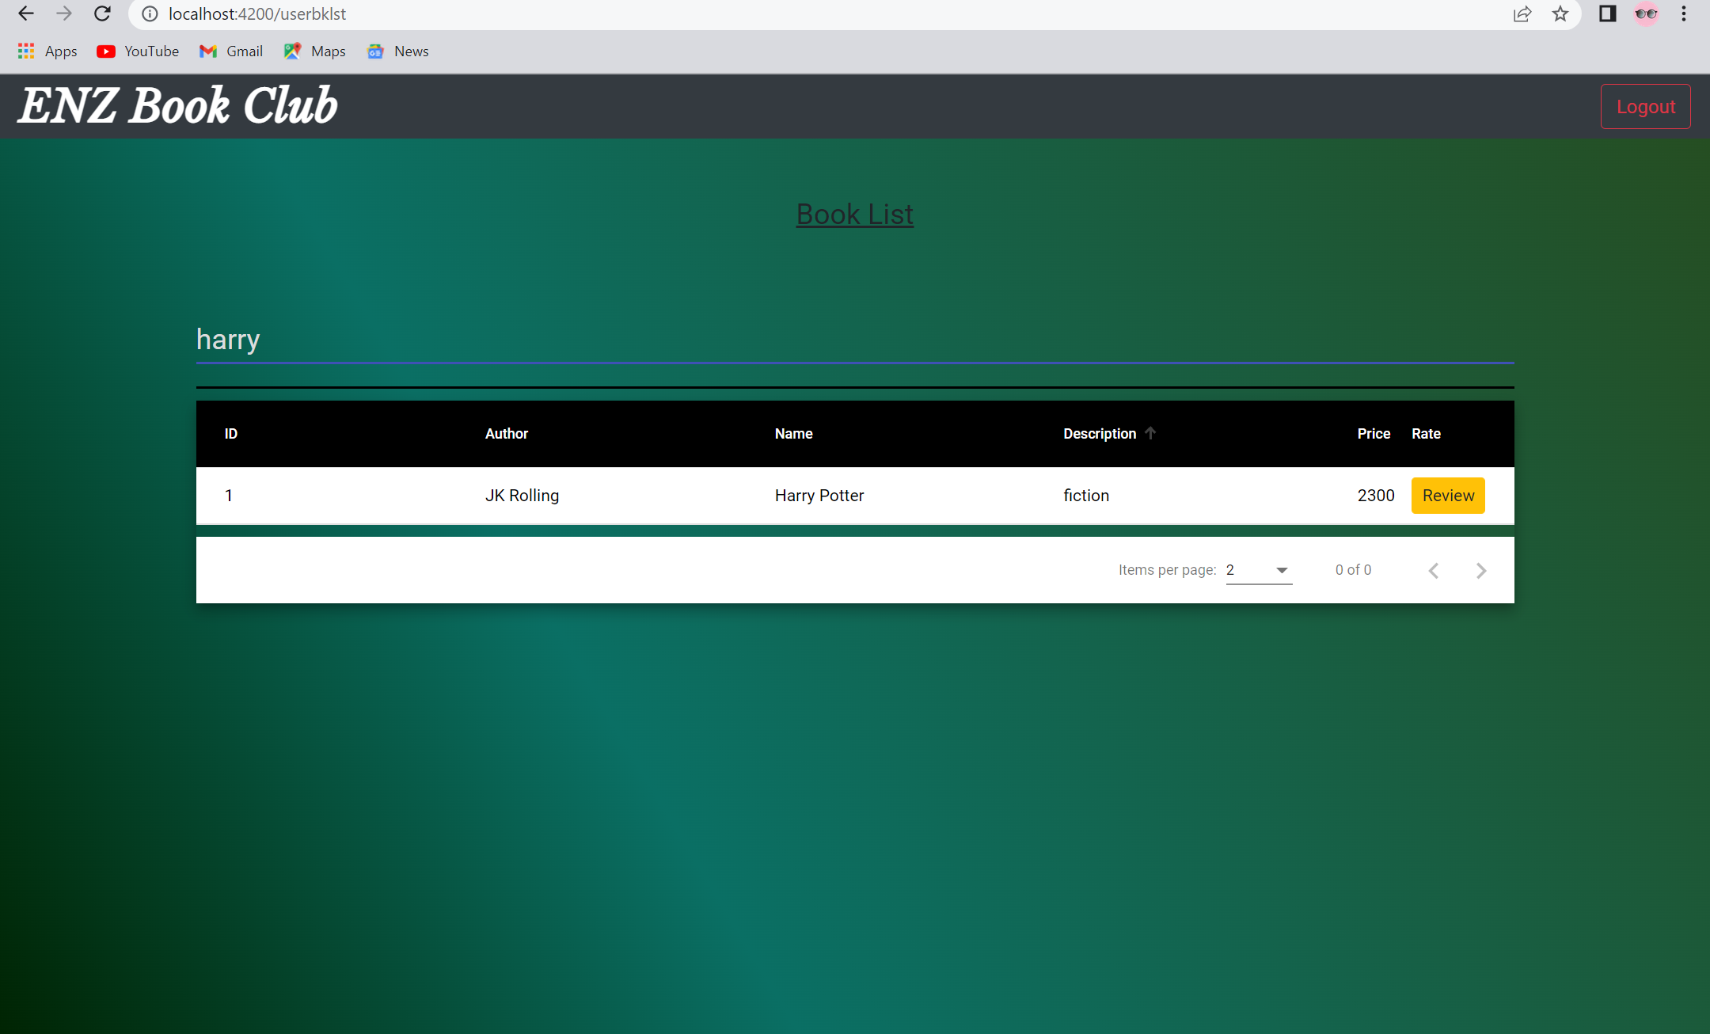
Search for books based on the search keyword
Enter search keyword in search box and related search results appear in book list

Slide 32
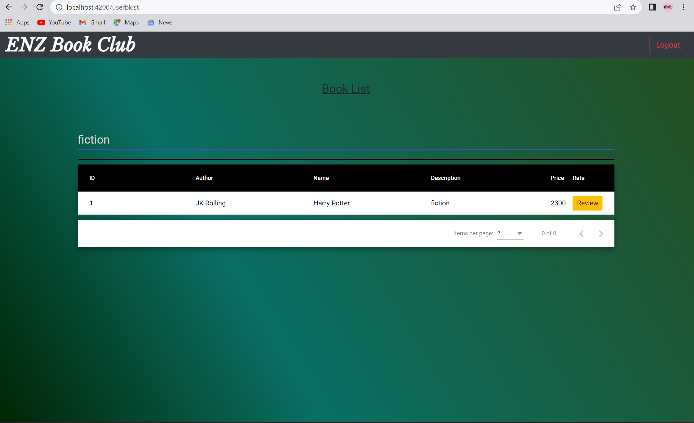
Apply filters and sort results based on categories

Slide 33
Like, comment and review books
Click “Review” to enter book review

Slide 34
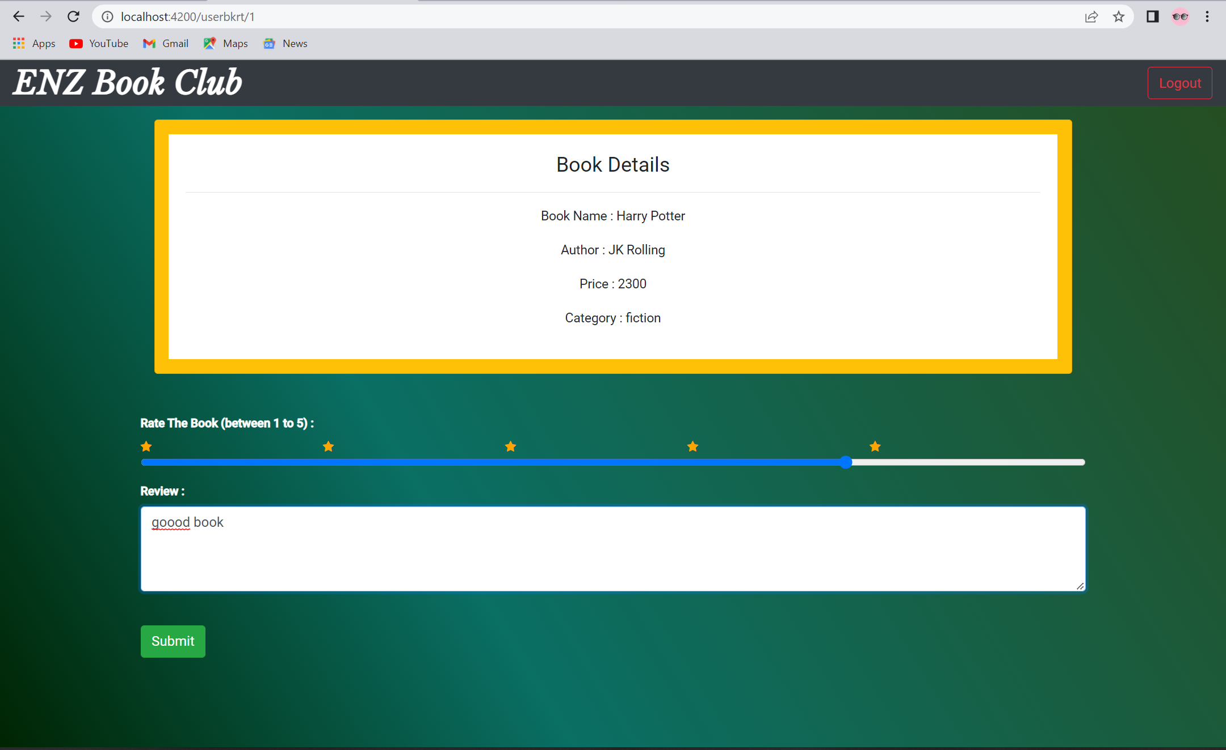
Like, comment and review books
Rate the book here
Type a review about the book here
Click “Submit” to submit rating and review

Slide 35
Future scope
We can improve our project by adding different colleges, and then filter books according to college.
Further we want to add a recommendation system which will suggest the books according to his previous searches.
We also want to integrate Google Maps API so that buyers can get the exact location of the seller.
Further we can work on our UI to improve the user experience.

Slide 36
Acknowledgement
We would like to thank Mphasis and Mphasis Learning Academy for organizing the RLL Team Project Program.
We also thank Mr. Anup Kini, Mr. Manpreet Bindra, Mr. Pradeep Chinchole and Mr. Sahil Mishra for mentoring us during the whole project.

Slide 37
Thank You

